Slide 1
Unit - V
Managing Files and Directories : Create and edit text files, Search for files, Perform operations on files and directories, Process text files, Manipulate file output
Managing Kernel Modules : Explore the linux kernel, Install and configure kernel modules, Monitor kernel modules,
Managing the Linux Boot Process : Configure linux boot components, Configure GRUB2

Slide 2
Create and Edit Text Files
TEXT EDITORS: A text editor is an application that enables you to view, create, or modify the contents of text files.
Vim
Nano

Slide 3
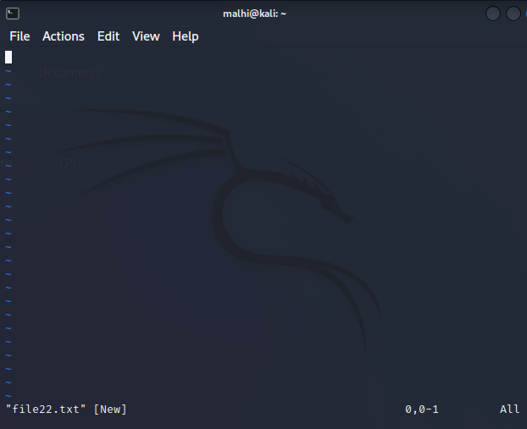

vim
Press i to enter into insert mode
Then write your content
After writing, exit from insert
mode by pressing escape key
To save write :wq

Slide 4
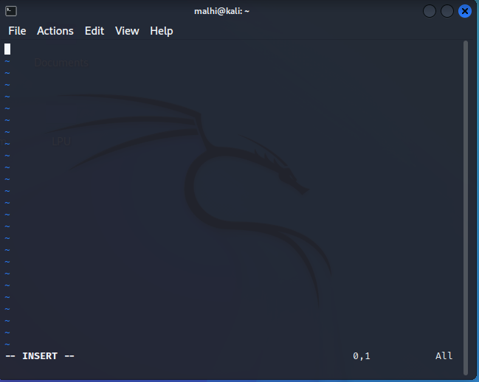
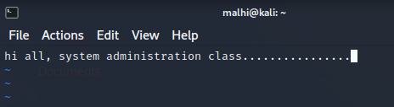


Slide 5

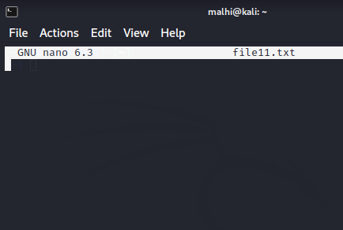
nano
nano

Slide 6
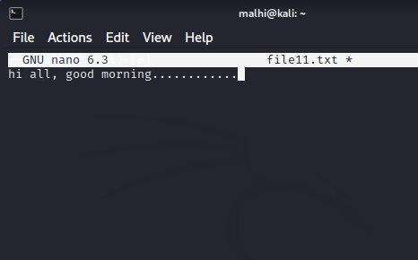

Ctrl + O to save
Ctrl + C to cancel the current
work
Ctrl + X to exit
Then press Y

Slide 7
Search for Files
There will be times that you create a file and forget where in the directory structure you put it.
There will also be times when you don't know the exact location of files created by the system, applications, or other users.

Slide 8
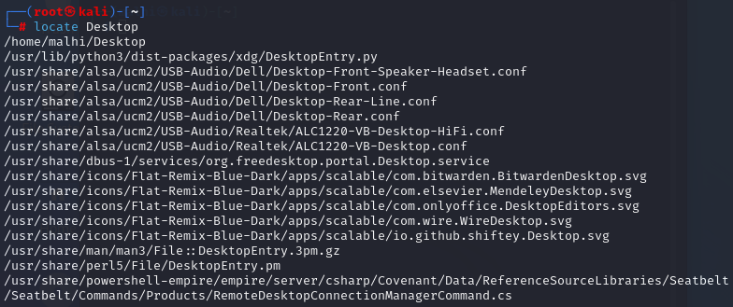
THE locate COMMAND
The locate command performs a quick search for any specified string in file names and paths stored in the mlocate database.

Slide 9
If locate command is not working, then needs to update the db used by locate command.
sudo updatedb

Slide 10
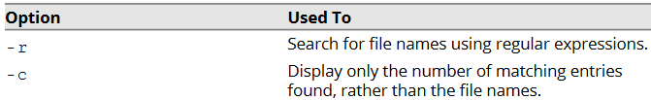
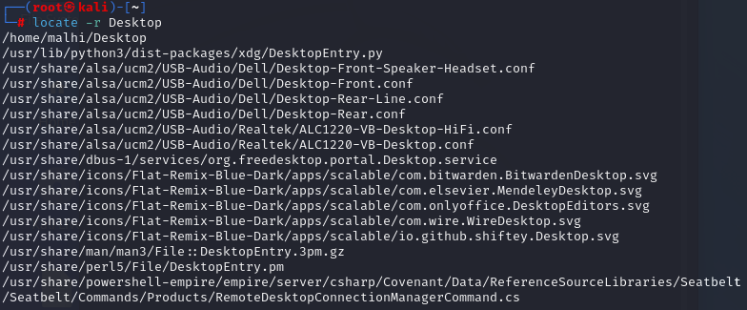

locate COMMAND OPTIONS

Slide 11
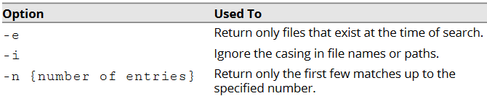
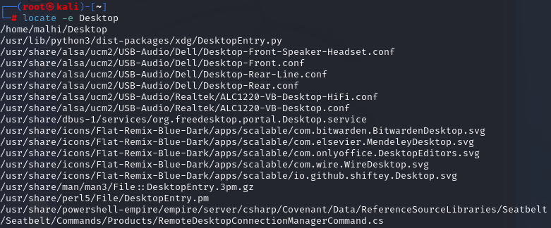

Slide 12
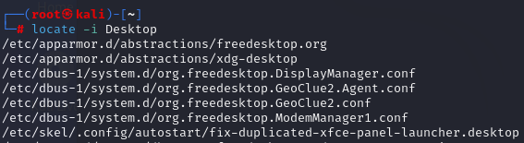

Slide 13
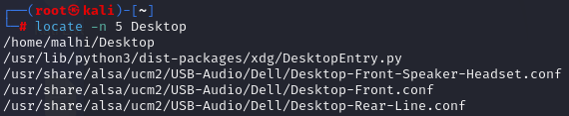

Slide 14

THE find COMMAND
The find command enables you to search a specific location for files and directories that adhere to some search criteria.
The -type option enables you to specify the type of object you're looking for, such as d for directory or f for file. The -name option is where you specify the name of the object you're looking for.
find /home/user -type f -name 2019_report

Slide 15


Slide 16




Slide 17


Slide 18
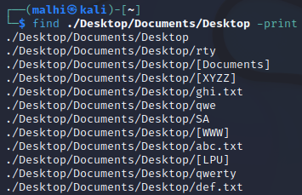

Slide 19
find VS. locate COMMANDS
The locate command searches a database and retrieves information on files present on your system.
However, failure to keep this database updated may produce outdated results.
The find command, on the other hand, performs a live search of the file system and may concentrate on a specific location.
The find command may take more time to complete a search than the locate command.

Slide 20
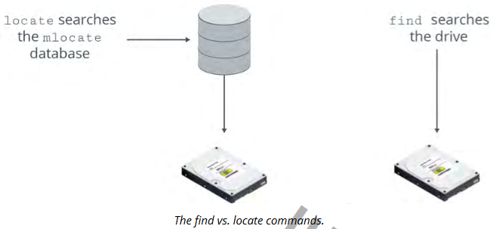

Slide 21
What are some advantages of using the find command over using the locate command?
The locate command requires that a database be updated in order to perform accurate searches, whereas find does not. Also, locate cannot filter its search by specific directories, whereas find can. However, locate may be able to perform searches more quickly in certain cases.

Slide 22

THE which COMMAND
The which command displays the complete path of a specified command by searching the directories assigned to the PATH variable.

Slide 23

THE whereis COMMAND
The whereis command is used to display various details associated with a command.
Where /bin/ls indicates the location of the ls command and /usr/share/man/man1/ls.1.gz /usr/share/man/man1p/ls.1p.gz indicates the location of the man pages for the ls command.
Displaying location information for a command.

Slide 24


Slide 25
Perform Operations on Files and Directories
There are many ways you can manage a file once you've created and edited it to your liking.
THE cat COMMAND: The cat command, short for concatenate, can display, combine, and create text files. It is most frequently used to display the contents of small text files, as it does not have a screen scrolling capability.

Slide 26
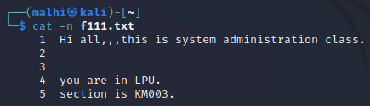

Slide 27
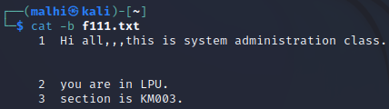

Slide 28
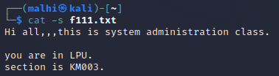

Slide 29
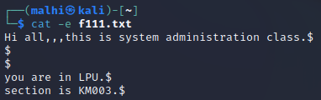

Slide 30
THE head AND tail COMMANDS
The head command displays the first 10 lines of each file. The tail command displays the last 10 lines of each file.
These commands are useful when you only need to see the beginning or the end of a file.

Slide 31
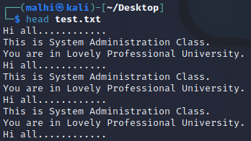
head
displays the first 10 lines

Slide 32
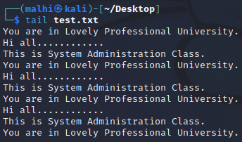
tail
displays the last 10 lines

Slide 33
THE cp COMMAND
The cp command enables you to copy and then paste a file or directory.
The initial object is left where it is, but an exact duplicate of that object is created at the destination you specify.
When you copy directories, you must specify the -R option to copy the specified directory recursively.

Slide 34
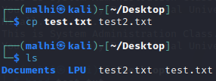

Slide 35
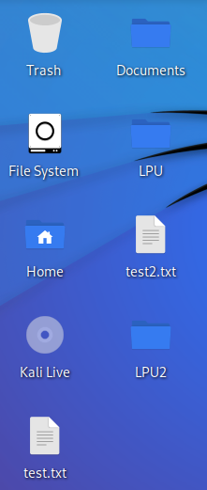
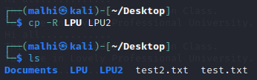

Slide 36
THE mv COMMAND
The mv command moves files and directories to other locations.
It is similar to the cp command, but does not leave the initial object in place.
Therefore, mv is more like a cut and paste operation.

Slide 37
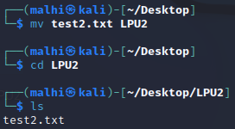

Slide 38
ls COLORS
In the Bash shell, when you execute the ls command, you may have noticed that the results sometimes appear in different colors.
These colors distinguish different types of files.
By default, some of the colors are:
Default color: Normal/text file
Blue: Directory
Sky blue: Symbolic link or audio file
Green: Executable file

Slide 39
Yellow with black background: Device
Pink: Image file
Red: Archive file
Red with black background: Broken link

Slide 40

THE mkdir AND rmdir COMMANDS
The mkdir command is used to create (or make) a directory. You supply the name of the directory as an argument.
The rmdir directory is used to remove directories, but only those that are empty (i.e., contain no files or subdirectories).

Slide 41


In order to delete a with actual contents, you must use the rm -R command.

Slide 42
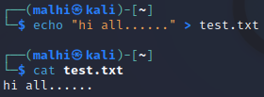

Process Text Files
THE echo COMMAND The echo command is used to display a line of text on the terminal.
You can also use the echo command to write text to a file by providing the string after the echo command and redirecting to the file.

Slide 43
The echo command can overwrite the content in the file by redirecting and not appending.
echo “Hello all…” >> test.txt
The above command will not overwrite, it will append

Slide 44

THE printf COMMAND
The printf command is similar to echo, but provides the user with much more control over how the output is formatted.
You can supply various format characters within the text you want to output, using a backslash (\) to indicate when they are being used.

Slide 45
THE tr COMMAND
The tr command is used to translate a string of characters.
It is predominantly used to change the case of letters in a file.
This command acts only on a stream of characters and does not accept file names as arguments.
You must use redirection to actually change a file.

Slide 46
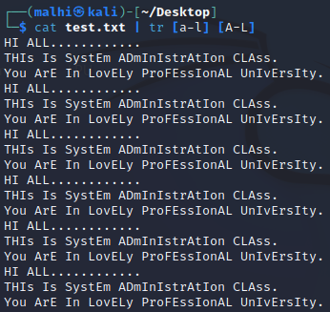

Slide 47
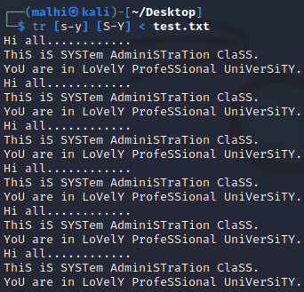

Slide 48

THE wc COMMAND
The word count (wc) command is used to count the number of lines, words, and characters in a text file.

Slide 49
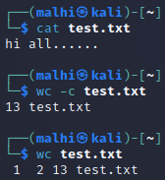
The wc command provides various options that enable you to specify the nature of the output.
-c Display the byte count.

Slide 50

-m Display the character count.

Slide 51
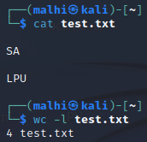
-l Display the newline count.

Slide 52

-w Display the word count.

Slide 53
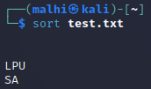
The sort command arranges the lines in a file.

Slide 54
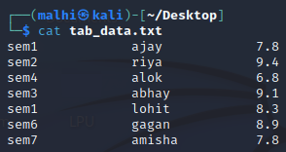
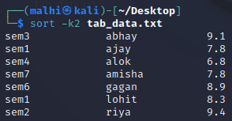
-k{column numbers} Specify field values. For example, -k2 indicates the second field.

Slide 55
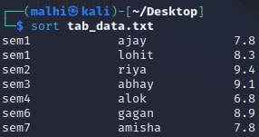
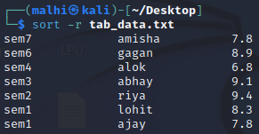
-r Sort fields in descending order.
By default, the fields are sorted in ascending order.

Slide 56
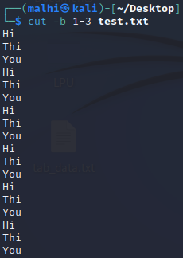
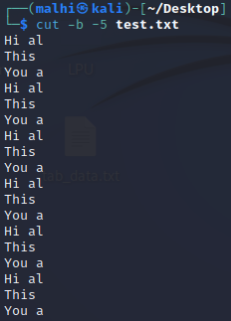
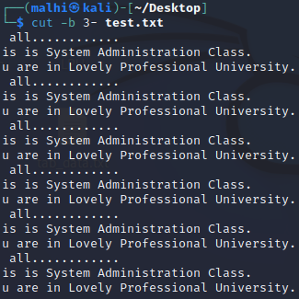
THE cut COMMAND
The cut command extracts the specified lines of text from a file.

Slide 57
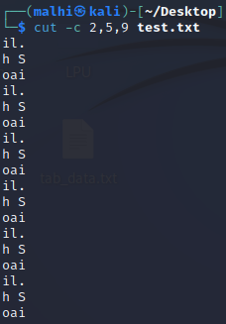
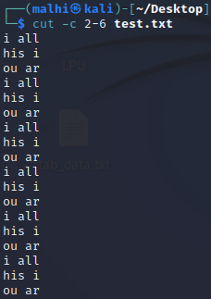
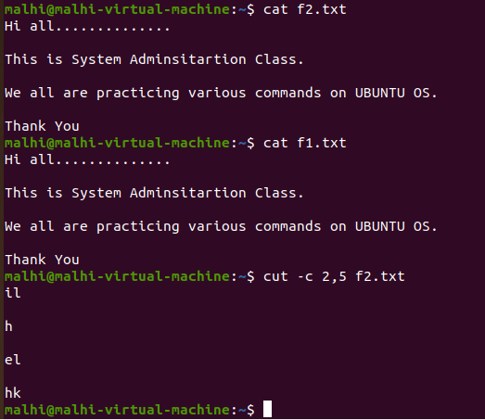
-c Specify the number of the character to cut from each line.

Slide 58
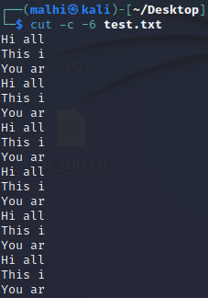
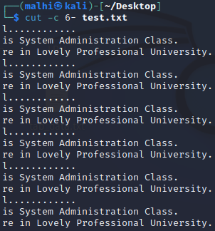

Slide 59


THE paste COMMAND
The paste command is used to merge lines from text files horizontally.

Slide 60
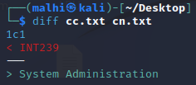
THE diff COMMAND
The diff command is used to compare text files. The command displays the two files and the differences between them.
1c1 means that line 1 in the first file needs to be changed to match line number 1 in the second file.

Slide 61
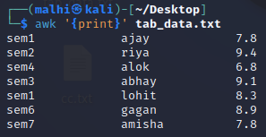

THE awk COMMAND
The awk command performs pattern matching on files.

Slide 62
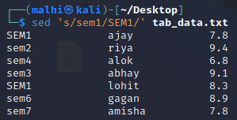
THE sed COMMAND
The sed or stream editor command is a program that you can use to modify text files according to various parameters. The sed command can also be used for global search and replace actions.
s Substitute the first occurrence of the string in the file.

Slide 63
$ sed 's/sem1/SEM1/2' tab_data.txt
$ sed 's/sem1/SEM1/g' tab_data.txt

Slide 64
THE ln COMMAND
The ln command is used to create a link to a file.
Linking enables a file name in one directory (the link) to point to a file in another directory (the target).
A link does not contain data of its own, only a reference to the target file.
Any changes to the link will reflect in the target file.
If you don't specify the link name, the ln command will create the link in your current working directory.

Slide 65
TYPES OF LINKS Using the ln command, you can create two types of links: hard and symbolic (soft).
Hard and symbolic links are a feature of the file system and are common in most file systems supported by Linux. The ext2, ext3, ext4, and XFS file systems all support hard and symbolic links.
A hard link is a reference to another file; it enables the file's data to have more than one name in different locations in the same file system. Applications treat a hard link as a real file. If the original file is deleted after a hard link is created, all its contents will still be available in the linked file. This is because the inode of a hard link is the same as its target; in other words, it points to the same object on the file system. Hard links cannot be created between two directories, nor can they be created between two files in different file systems.

Slide 66
A symbolic link is a reference to a file or directory that can span multiple file systems. If the original file or directory is deleted after a symbolic link is created, then the original content is lost.
This is because the inode of a symbolic link is different than its target; in other words, it points to a different object on the file system.
A symbolic link is also known as a soft link.

Slide 67
A link in UNIX is a pointer to a file.
Like pointers in any programming languages, links in UNIX are pointers pointing to a file or a directory.
Creating links is a kind of shortcuts to access a file.
Links allow more than one file name to refer to the same file, elsewhere.

Slide 68
There are two types of links :
Soft Link or Symbolic links
Hard Links

Slide 69
These links behave differently when the source of the link (what is being linked to) is moved or removed.
Symbolic links are not updated (they merely contain a string which is the path name of its target);
hard links always refer to the source, even if moved or removed.

Slide 70
For example, if we have a file a.txt.
If we create a hard link to the file and then delete the file, we can still access the file using hard link.
But if we create a soft link of the file and then delete the file, we can’t access the file through soft link and soft link becomes dangling.

Slide 71
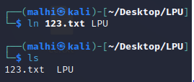
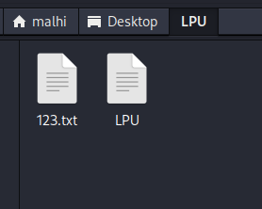

Slide 72
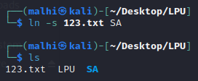
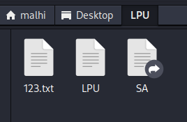

Slide 73
Manipulate File Output
TEXT STREAMS: A text stream is a sequence of one or more lines of text that applications can leverage to read from or write to a particular device or system component.

Slide 74
Standard input, or stdin, is a text stream that acts as the source for command input. Standard input for the Linux command-line is usually generated from the keyboard. In the case of the GUI, the standard input can also come from the mouse.

Slide 75
Standard output, or stdout, is a text stream that acts as the destination for command output. By default, standard output from a Linux command is directed to the CLI.
Standard error, or stderr, is a text stream that is used as the destination for error messages. By default, the standard error stream prints error messages at the CLI.

Slide 76
INPUT/OUTPUT REDIRECTION Redirection is the process of accepting input data from a source other than the keyboard and sending output data to a destination other than the display device.
REDIRECTION OPERATORS There are several operators that are used to redirect input or output.

Slide 77
PIPING
Piping is the process of combining the standard I/O streams of commands. It uses the standard output of one command as the standard input for another command. The output format of the first command should be compatible with the format that the second command works with. The pipe operator (|) can be used with most commands in Linux.

Slide 78


Slide 79


Slide 80
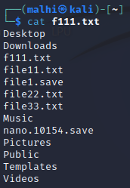

Slide 81


Slide 82


Slide 83


Slide 84

Display the top 5 files/directories according to their size in the current working directory

Slide 85

THE xargs COMMAND (extended arguments)
The xargs command reads from standard input and executes a command for each argument provided.
It shows the content of file.(read from file instead of standard input)

Slide 86

THE tee COMMAND
The tee command reads the standard input, sends the output to the default output device (the CLI), and also copies the output to each specified file.

Slide 87
Managing Kernel Modules
The kernel is the core of an operating system. All other components rely on it.
The kernel manages file system access, memory, processes, devices, and resource allocation on a system.
The kernel also controls all the hardware devices plugged into the system.
It is one of the first elements to be loaded on startup and remains in the main memory during the computer's operation.
The kernel also contains system-level commands and other functions that are normally hidden from users.

Slide 88
The kernel space is simply where the kernel executes the services that it provides.
The user space is the area of memory that includes everything outside of kernel space.

Slide 89
TYPES OF KERNELS
Kernels can be classified as monolithic or microkernel. In a monolithic kernel, all system modules, such as device drivers or file systems, run in kernel space. As a result, a monolithic kernel can interact quickly with devices.
In a microkernel architecture, the kernel itself runs the minimum amount of resources necessary to actually implement a fully functional operating system. Compared to monolithic kernels, microkernels have smaller kernel spaces and instead have larger user spaces.

Slide 90
A device driver is a software program that enables a computer's operating system to identify the characteristics and functions of a hardware device, communicate with it, and control its operations. It acts as an interface between the operating system and hardware devices such as storage drives, printers, scanners, monitors, and keyboards. Device drivers can be included in the operating system or installed on demand.

Slide 91

THE uname COMMAND
By default, uname prints the name of the kernel—Linux. You can view the kernel version number of your current system by using the uname -r command. You can also enter uname -i to view the hardware platform. To print all information, enter the uname -a command.

Slide 92
KERNEL LAYERS
The kernel performs various functions to control and manage the operations of a system. It is composed of several layers that operate in kernel space.
System Call Interface (SCI): Handles system calls sent from user applications to the kernel.

Slide 93
Process management: Handles different processes by allocating separate execution space on the processor and ensuring that the running of one process does not interfere with other processes.

Slide 94
Memory Management
Manages the computer's memory, which is one of the complex tasks performed by the kernel. Like processor sharing, the system's memory also needs to be shared among different user space resources. The kernel maps or allocates the available memory to applications or programs on request and frees the memory automatically when the execution of the programs is complete, so that it can be allocated to other programs.

Slide 95
File system management: Manages the filesystem, which involves storing, organizing, and tracking files and data on a computer.
Device management: Manages devices by controlling device access and interfacing between user applications and hardware devices of the computer.

Slide 96
Install and Configure Kernel Modules
A kernel module is a system-level object that extends the functionality of the kernel. It can be dynamically loaded into the kernel or unloaded from the kernel when required. It enables the kernel to update or recompile itself without requiring the system to reboot.
The advantages of kernel modules are: • They reduce the burden on the kernel because otherwise all of the modules' functionality would have to be added directly to the kernel. • Dynamic loading of kernel modules facilitates lower memory consumption. • They avoid having to rebuild and reboot the system when new functionality is required. Kernel module file consists of a .ko extension. Modules built for a specific kernel version may not be compatible with another version of the kernel.

Slide 97

KERNEL MODULE MANAGEMENT COMMANDS
Kernel module management commands enable you to view, load, unload, or modify kernel modules.
lsmod: Display the currently loaded kernel modules, their sizes, usage details, and their dependent modules.

Slide 98
THE modprobe COMMAND
The modprobe command is used to add or remove modules from a kernel.

Slide 99
THE depmod COMMAND
In order for modprobe to accurately install dependent modules, it reads the modules.dep file to identify how modules are linked to one another. The depmod command is used to update this database of dependencies so that modprobe can function properly.

Slide 100
KERNEL MODULE CONFIGURATION
The /etc/modprobe.conf file is a configuration file that contains settings that apply persistently to all the modules loaded on the system.
It is used to configure modules and their dependencies and also specify module aliases.
An alias is just an alternative name to use for a module.

Slide 101
KERNEL PARAMETERS
In addition to loading modules into the kernel at runtime, you can also change some of the kernel's parameters while it is running.
You can use these parameters to improve system performance, harden security, configure networking limitations, change virtual memory settings, and more.

Slide 102

THE sysctl COMMAND
The sysctl command is used to view or set kernel parameters at runtime. It has various options.
-a Display all parameters and their current values.

Slide 103
Monitor Kernel Modules
After you install and configure kernel modules, it's a good idea to monitor those modules.
In this, you'll verify that the modules you installed were actually loaded into the kernel, and that any configurations you made were implemented properly.

Slide 104

THE /proc/ DIRECTORY
The /proc/ directory is a virtual file system (VFS) that provides significant information about the kernel's running process.

Slide 105
THE /proc/version FILE
The /proc/version file specifies several points of information about the Linux kernel:
• The version of the Linux kernel currently running. • The version of the GNU Compiler Collection (GCC) used to compile the kernel. • The user name of the kernel compiler. • The time the kernel was compiled.

Slide 106



Slide 107

THE dmesg COMMAND
The dmesg ("display message" or "driver message") command is used to print any messages that have been sent to the kernel's message buffer during and after system boot. Device drivers send messages to the kernel indicating the status of modules and parameters that the drivers interface with. These drivers can also send diagnostic messages to the kernel in case they encounter errors.

Slide 108
Managing the Linux Boot Process
Configure Linux Boot Components: Booting is the process of starting or restarting a computer and loading an operating system for the user to access. In the boot process, a booting environment reads a small program that is stored in read-only memory (ROM). This program then executes various operations in RAM that bootstrap the operating system and make it available for use.

Slide 109
A boot loader is the small program stored in ROM that loads the kernel from a storage device, and then starts the operating system. A boot environment like BIOS reads the boot loader from ROM so that the boot loader can execute the necessary operations to start the process.

Slide 110
The Basic Input/Output System (BIOS) is a standard for firmware interfaces and is stored on a computer motherboard's ROM chip. When a computer with BIOS is powered on, the BIOS firmware is the first to run; this enables it to test the various hardware components in a computer, as well as run a boot loader so that an operating system can start.

Slide 111
UEFI
Unified Extensible Firmware Interface (UEFI) is newer firmware technology that has largely replaced BIOS by bringing with it several key advantages. UEFI runs faster than BIOS, can operate within a greater amount of memory, can access storage drives of currently unattainable sizes, can access more hardware types, and has improved security protections. Most modern motherboards, as well as the pre-assembled PCs that use them, ship with UEFI.

Slide 112
A sector is the smallest unit of storage read from or written to a drive. A sector stores 512 bytes of data by default. On hard disk drives, a collection of sectors is called a track. The number of sectors in a track may vary, and so does their capacity to hold data.

Slide 113
The master boot record (MBR) is the first physical sector on a storage drive and a type of partition structure. The MBR boot sector contains the boot loader that loads the operating system into memory. It also contains the partition table of the storage drive. MBR determines what sectors are available to each partition, as well as which partition is considered bootable and which partitions are not.

Slide 114
The GUID Partition Table (GPT) is a successor to MBR that makes up for the latter’s shortcomings. Like MBR, it is a partition structure, but it employs a more modern design and is part of the UEFI standard. Every partition on a drive is assigned a globally unique identifier—a GUID—to distinguish it from every other partition on (theoretically) every drive.

Slide 115
initrd
The initial ramdisk (initrd) refers to the root file system that is temporarily loaded into memory upon system boot. The initrd loads along with the kernel, which controls its functionality. The initrd enables the system to be started in two phases. In the first phase, the system is booted with the minimal set of modules required to load the main or the permanent root file system. In the second phase, when the main root file system is mounted, the previously mounted initrd file system is removed and the user space boot process continues.

Slide 116
THE initrd IMAGE
The Linux initrd image is an archive file containing all the essential files that are required for booting the operating system.

Slide 117
THE mkinitrd COMMAND
The mkinitrd command is used to create the initrd image for preloading the kernel modules.

Slide 118
THE /boot/ DIRECTORY
As defined by the Filesystem Hierarchy Standard (FHS), the /boot/ directory contains files that are used to facilitate the Linux boot process.

Slide 119
THE dracut COMMAND
The dracut command is used to generate an initramfs image, similar to how mkinitrd is used to generate an initrd image.

Slide 120

THE BOOT PROCESS
The boot process is repeated each time your computer is started by loading the operating system from a storage device. It involves a series of sequential steps that can be divided into BIOS/UEFI initialization, boot loader, kernel and initrd/initramfs initialization, and boot scripts.

Slide 121
1. The processor checks for the BIOS/UEFI firmware and executes it. This is also where the power-on self-test (POST) occurs.
2. BIOS/UEFI checks for bootable media from internal storage devices or peripherals like USB thumb drives and DVD-ROMs. It locates a valid device to boot the system.
3. BIOS/UEFI loads the primary boot loader from the MBR/GPT partition into memory. It also loads the partition table along with it.
4. The user is prompted by GRUB 2 to select the operating system they want to boot. If the user does not respond, then the default operating system will be booted.

Slide 122
5. The boot loader determines the kernel and locates the corresponding kernel binary. It then uploads the respective initrd image into memory and transfers control of the boot process to the kernel.
6. The kernel configures the available hardware drivers, including processors, I/O subsystems, and storage devices. It decompresses the initrd image and mounts it to load the necessary drivers. If the system implemented any virtual devices, such as LVM or software RAID, then they are initialized.
7. The kernel mounts the main root partition and releases unused memory. To set up the user environment, the systemd program is run. It becomes process ID 1.
8. The systemd program searches for the default.target file, which contains details about the services to be started. It mounts the file system based on the /etc/fstab file and begins the process of starting services. On most systems, the target will either be multi-user.target or graphical.target.

Slide 123
9. If graphical mode is selected, then a display manager like XDM or KDM is started and the login window is displayed on the screen.
10. The user enters a user name and password to log in to the system.
11. The system authenticates the user. If the user is valid, then various profile files are executed.
12. The shell is started and the system is ready for the user to work on.

Slide 124
KERNEL PANIC
Kernel panic is a mechanism by which the system detects there has been a fatal error and responds to it. A fatal error typically results in the system becoming unstable or totally unusable. Software that handles kernel panics will display an error message to the user and dump the current state of kernel memory to a storage device for later debugging. Depending on how the system is configured, the panic handler will either reboot the system automatically, or wait for the user to do so.

Slide 125
Configure GRUB 2
GNU GRUB: The GNU GRand Unified Bootloader (GNU GRUB) is a boot loader developed by the GNU Project that became popular on Unix-like systems. It enables users to choose which operating system or kernel version to boot in a multi-platform environment.

Slide 126
GRUB 2 IMPROVEMENTS
GRUB 2 is more than simply a newer version of GRUB; it is a complete redesign and rewrite of the GRUB system. GRUB 2 offers administrators more control over the boot process, boot devices, and boot behavior.

Slide 127
GRUB 2 INSTALLATION
The grub2-install command is used to install the GRUB 2 boot loader on a storage device. It copies GRUB 2 files into the /boot/grub2 directory and, on some platforms, installs GRUB 2 into the boot sector. However, grub2-install applies to BIOS systems, not UEFI. To install GRUB 2 on a UEFI system, use a package manager to install the grub2-efi package. Installing this package will copy GRUB 2 files onto the EFI system partition (ESP) in the /boot/efi directory.

Slide 128
THE grub.cfg FILE
The grub.cfg file is the main configuration file for the GRUB 2 boot loader. On BIOS systems, it is located in the /boot/grub2/ directory. On UEFI systems, it is located in the /boot/efi/EFI/<distro>/ directory.

Slide 129
THE /etc/grub.d/ DIRECTORY
The /etc/grub.d/ directory contains scripts that are used to build the main grub.cfg file.

Slide 130

THE /etc/default/grub FILE
The /etc/default/grub file contains GRUB 2 display menu settings that are read by the /etc/grub.d/ scripts and built into the grub.cfg file. It enables you to change options such as how many seconds GRUB 2 will wait before automatically selecting the default boot option.

Slide 131
THE grub2-mkconfig COMMAND
The grub2-mkconfig command generates a new grub.cfg configuration file, and is used to update an existing grub.cfg file.

Slide 132
ADDITIONAL READING IS STRONGLY RECOMMENDED

